Slide 1

WORK PERMIT SYSTEM

Slide 2
AGENDA
1
Introduction
2
Work permit requirement
3
Work permit signing
4
Work permit issuer
5
Work permit executor
6
Work permit validity, recordkeeping
7
Safety requirements, gas test and electrical isolation
8
Cold work permit
9
Hot work permit
10
Confined space entry authorization
11
Excavation authorization
Notes:
2

Slide 3
INTRODUCTION
The Work Permit specifies the conditions and procedures for safe execution of the work and allows the work to be carried out under controlled conditions.
The basic purpose of the Work Permit System is to assign the responsibility of each party for the safe execution of the work; i.e. prevent injuries to personnel, protect property from damage, avoid fire/explosion and ensure that all work is carried out in the safest possible manner.
The Work Permit authorizes specific work to be carried out in Work Permit Area.
The conditions set out on the Work Permit are meant as general guidelines and shall not be assumed to cover every condition or circumstances that may be present or may arise during the course of the work.
The Permit in itself does not make the job safe but shows to what extent the job has been made safe.

Slide 4
WORK PERMIT REQUIREMENT
No work shall be carried out without a proper Work Permit unless such work or area has been declared permit free
WORK REQUIRING A PERMIT- A Work Permit is required for jobs including, but not limited to the following:
  Maintenance Work (mechanical, electrical, instrument, civil, etc.)
  Construction and project work
  Alterations/modifications
  Process equipment cleaning activities
  Inspection and condition monitoring
  Work inside Confined Space
  Excavation
  Vehicle/mobile equipment entry into Hazardous Areas
  Underwater maintenance, marine construction
  Other Activities serving the refinery operations
  Non-routine work in workshops, warehouse, etc.

Slide 5
WORK PERMIT REQUIREMENT
WORK NOT REQUIRING A PERMIT- A Work Permit is NOT required for following routine work, when carried out by the respective craft:
  Routine work carried out in established workshops and adjacent yards with fixed boundaries
  Routine material handling work in established warehouses and adjacent laydown yards with fixed boundaries
  Routine office work including cleaning, servicing of office equipment, communication equipment, and furniture
  Maintenance cold work in buildings outside hazardous area (other than control rooms), which does not exceed climbing of ladder or scaffold over 2 meters. Ex. hand tool work, relamping, servicing of air conditioners, painting.
  Visual inspection or checking without using any tools in operation areas with verbal permission of the asset custodian (if such work involves confined space entry, confined space authorisation is required)
  Work carried out by Operations Dept. personnel as part of their routine operations, start-up and shutdown (ex. Operating valves, pumps, etc.)

Slide 6
WORK PERMIT REQUIREMENT
TYPES OF WORK PERMITS & AUTHORISATIONS
  There are two types of Work Permits with specific colours assigned for easy identification.
  Other "Associated Authorisations" are also required depending on the nature of work.
Cold Work Permit (green permit) is required for any work that does not involve use of or generate a source of ignition.
Hot Work Permit (red permit) is required for any work that involves use of or generates a source of ignition capable of igniting a flammable mixture or combustible material.
Confined Space Entry Authorization (yellow permit) is associated with work permit for personnel entry into a confined space
Excavation Authorization is associated with work permit for excavation work.
Other Authorisations such as Vehicle Safety Certificate, Electrical Isolation Tag, etc shall also be required as applicable.

Slide 7
WORK PERMIT SIGNING
The eligibility and training requirements for personnel eligible to sign a work permit as issuer or executor are described in the following sections.
  The Department Head shall ensure that personnel nominated to attend training for signing work permit meet the following requirements.
    Has basic safety knowledge: attended training in this regard which should generally cover basic safety at work, PPE, emergency actions, first aid fire fighting, basic awareness of work permit system, work place hazards, etc.
    Has craft specific safety knowledge: attended training covering the safety aspects of employee’s craft.
  The respective Safety Division shall train, test and certify the nominated person for signing the Work Permit as Issuer or Executor. Validity of certification shall be a maximum of 2 years.
  Each Division Superintendent shall maintain a record of Certified Issuers/Executors and apply for timely renewal or new authorisations.

Slide 8
WORK PERMIT ISSUER
Issuer (Issuing Authority)
  Operation Issuers: The Shift Supervisor or above shall only be granted authority to issue all types of work permits in operation areas.
  Control Room Operators may be authorised as issuers for special circumstances such as shutdown.
  Operations Manager may authorise lower level personnel subject to the conditions.
  Other Issuers: Other asset custodians or technical personnel in office buildings can be authorised to issue all types work permits in their respective areas.
    Shift Fire officer, Lab Shift supervisor and above
    Supervisor level or above of workshop, warehouse (normal work-hours) Supervisor or above person with technical background, assigned as custodian for an office building (ex. One of the engineers in Operation or Main. Bldg.)

Slide 9
WORK PERMIT ISSUER
Shift Safety Engineer/ Shift Leader shall issue permits for areas without designated asset custodian (ex. Main roads, main substations, scrap/salvage yards, etc). He shall also issue permits for areas with custodian issuers outside their work-hours.
Authorised Projects personnel shall issue permits for fenced Project sites outside unit boundaries.
If the work affects or can impact safety of adjoining/other Unit/Department, the other affected Unit/Department Issuer shall countersign the permit to indicate awareness of the job. (ex. Work on Unit-A pipeline crossing Unit-B, supervisor of Unit-B also should countersign in issuer column).
Issuer’s Division senior should ensure the number of permits to be signed by one issuer in a day/shift does not hamper his primary duty of running the plant safely. If overloaded other issuers such as shift controller or section head should cover to have effective control of work.

Slide 10
WORK PERMIT ISSUER
Issuer Responsibilities
  Issuing authority is responsible for preparation and handing over of the equipment in safe condition to perform the work.
  His signature as issuer shall mean understanding the job, safe handing over and monitoring of site conditions.
  Issuer shall decide whether the work is critical and inspect the work site with the executor before issuing the permit.
  He shall inform ECC about all critical work.
  He shall also inform ECC about road closures
  ECC shall log it and inform Safety.
  Immediately after signing, Issuer shall drop the safety copy in the box provided.
  The Field Operator shall read the work permit, check the site compliance to permit conditions and sign original permit with field operator copy (signing issuer copy is optional).
  He shall monitor the site conditions and executing group’s compliance to permit conditions.
  He shall register the work in his log..

Slide 11
WORK PERMIT EXECUTOR
Executor (Executing Authority)
  Authority to execute all types of work permits shall only be granted Foreman level of Maintenance Dept. and above.
  Assistant Foreman may be considered for special situations such as shutdown.
  Technician level should be considered only for cold work which is not related to opening of vessels, disconnecting lines in flammable or toxic service and radiography.
  Technicians can also be authorised to sign hot work related work.
  Separate permits are required for different crafts & jobs.
  Person holding valid executor card shall only sign permits for crew under his control.
  Equivalent categories of other Department personnel can be granted similar authority.
  Executing Division Supdt should ensure that each executor is not overloaded with too many permits, which can hamper effective supervision.

Slide 12
WORK PERMIT EXECUTOR
  Contractor’s personnel shall not be considered as executors.
  RM may approve requests for authorising Service Contractor’s personnel equivalent to Foreman as executors if there is a genuine shortage of personnel.
  Executing Division Supdt shall ensure that, such executors are not utilised when there are sufficient executors for the amount of permits in a given day.
Executor Responsibilities
  After checking the site, the Executor himself (not the deputies) shall request from the respective issuer, for a work permit to carry out the work .
  He shall forward associated authorizations to the issuer (for excavation, hot-tapping, etc.).
  He / She shall indicate the types of tools and equipment necessary for performing the work.
  He shall forward valid Safety Certificate for vehicles and engine driven equipment.
  He shall ensure that, the tools, equipment and accessories are in good condition.
  His signature indicates understanding and compliance to relevant conditions on (both sides of) the permit.

Slide 13
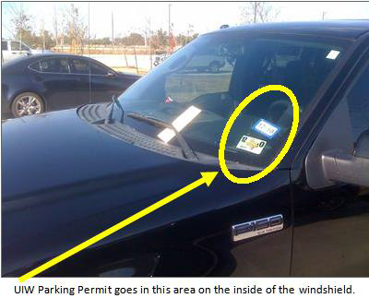
WORK PERMIT EXECUTOR
  Executor shall take “Original” and “Field Operator Copy” to the Field Operator and obtain the signature before starting the work (signing issuer copy is optional).
  Executor shall display the permit in suitable manner.
  Vehicle entry permit should be displayed on the back of the windshield.
  Transfer of Responsibility of Supervision - Executor of critical work shall remain in the work site.
  In case he has to leave the site at anytime, the work shall be suspended until the responsibility is transferred to another executor by renewal of the permit.
  Executor shall not sign more than one critical work permit unless it is in the same location/vicinity

Slide 14
WORK PERMIT VALIDITY, RECORDKEEPING
VALIDITY PERIOD OF WORK PERMIT.
  Maximum validity of initial issue of a Work Permit shall be for the duration of the work or until the end of the shift/ workday, whichever is less.
  The issuer or executor shall not sign for duration beyond their work-hours.
  The renewal of permit is a transfer of responsibility and an affirmation by the issuer/ executor that conditions are safe to continue the work.
  Extended duration of work permits for special tasks such as major turnarounds and major projects could be considered subject to written approval from Safety department.
  If work in hazardous area is not started or is stopped for over 2 hours for any reason the permit becomes invalid, It shall be renewed before starting or resuming the work. However the permit shall be closed if the work is not started/ resumed before the end of executor‘s workday.
  Non-hazardous area permits can be reused next work day without closing.

Slide 15
WORK PERMIT VALIDITY, RECORDKEEPING
SUSPENSION OF WORK PERMIT
  In case of an emergency, work shall be suspended and validity of any work permit ceases in the affected area.
  Executor or his crew shall immediately stop work when a fire or emergency alarm is sounded or accident of any kind occurs.
  Approval from the Incident Controller shall be obtained after necessary preliminary investigations, to resume such work.
  The Work Permit shall be renewed to resume the work after the fire or emergency is over.
  Issuer, his deputy or Safety is authorized to suspend work and withdraw the Work Permit, if the Permit conditions or Safety Regulations are violated and/or if the site conditions have changed leading to a hazardous situation.
  Person stopping the work shall immediately inform the reasons for stopping to the Issuer/Executor or their superiors.
  If work is not started or is suspended due to safety reasons after a Work Permit has been issued, the work shall only be started or resumed after establishing safe conditions and renewal of the Work Permit.

Slide 16
WORK PERMIT VALIDITY, RECORDKEEPING
CLOSING AND FILING
  Executor, Field Operator and Issuer shall fill and sign (Permit Closure) on the "Original” and “Field Operator Copy" of the work permit at the completion of work or the end of last renewal whichever comes earlier (closing issuer copy is optional).
  Objective of closing is, safe handing over of the site.
  “Original” which belongs to executor shall be filed and available with the supervisor in charge of execution of the job.
  “Field Operator copy” shall be filed and available at the issuing office.
  “Safety copy” which had been dropped in the permit box by the issuer shall be collected by the Area Safety Engineer every workday and filed.
  Safety engineer, who is the custodian of this box, shall ensure it is locked and not allowed to overfill.

Slide 17
WORK PERMIT VALIDITY, RECORDKEEPING
SAFETY FUNCTION
  Safety Section is an advisory and monitoring function.
  Hence Safety Engineers are not required to sign on the work permit unless he is the issuer or executor. He shall audit the work permit filling and compliance on a daily basis.
  Safety Engineer shall write his site instructions in the safety log maintained at issuer’s office with date, time & signature or issue official memo.

Slide 18
SAFETY REQUIREMENTS, GAS TEST AND ELECTRICAL ISOLATION
SAFETY REQUIREMENTS.
  Operations or the asset custodian shall prepare the equipment for safe execution of the work before handing over to executors.
  The extent of preparation depends on the nature of work
    cold work
    hot work
    confined space
Issuer shall tick all items of Section either 'Y' (yes) or 'N'/'NR' (no/not required or applicable).
GAS TEST FOR WORK PERMIT
  Gas tests are required for hot work and confined space entry.
  It may also be required for some cold work and excavations.
  Gas Test of Work Permit shall be filled to record results of Combustible, Toxic Gases and Oxygen concentration as applicable to the location of work.

Slide 19
SAFETY REQUIREMENTS, GAS TEST AND ELECTRICAL ISOLATION
  Issuer shall determine the requirement of gas test,
  the gases to be measured and frequency of repeating the test or the need for continuous monitoring.
  Minimum requirement shall be once at the beginning of shift/work.
  Authorised Gas Tester, who has been certified
  Safety and holding valid certification card , shall carry out the gas test using an approved gas meter.
  He/she shall check the meter in fresh air and keep it on before actual test.
  Combustible gas is measured as a percentage of Lower Explosive Limit For hot work, the reading at the point of work shall not exceed 1%, preferably 0%.
  For cold work without respiratory protection, breathing area LEL shall be less than 10%.
  At least 13% Oxygen is required to obtain an accurate LEL reading from a combustible gas meter. Hence, these cannot give a proper reading in inert atmospheres (ex. System purged with nitrogen or steam).
  Special test methods shall be adopted in such situations.

Slide 20
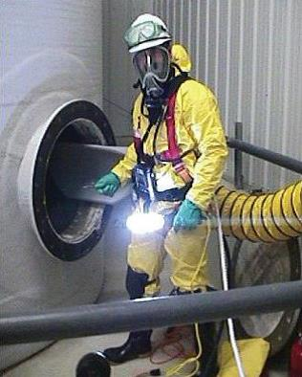
SAFETY REQUIREMENTS, GAS TEST AND ELECTRICAL ISOLATION
  Gas meters used for leaded gasoline shall be equipped with special filters to prevent damage to the sensor by lead resulting in reading errors.
  Gas tester wearing SCBA or carrying an escape mask shall test for Toxic gas, if the presence of toxic vapor or gases is known or suspected.
  Temperature and humidity are related to each other and do not have fixed limits.
  Precautions shall be taken such as air conditioning, work time adjustment, or special clothing depending on each situation.

Slide 21
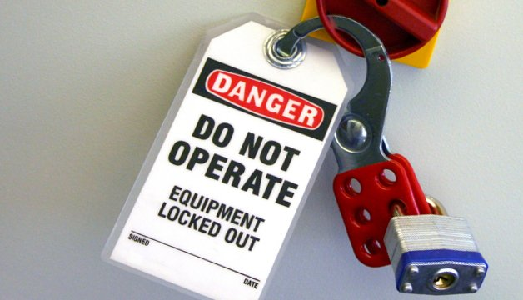
SAFETY REQUIREMENTS, GAS TEST AND ELECTRICAL ISOLATION
ELECTRICAL ISOLATION
  Before a Work Permit can be issued, it is essential to ensure that the equipment / facility to be worked on is electrically safe by isolating power to the extent necessary for the safe execution of the authorized work.
  Issuer, Executor and Electrical Maintenance shall jointly decide the extent of isolation required and fill Section of the Work Permit for electrical isolation.
  Authorised person from Electrical Maintenance shall isolate electrical power of the circuit/equipment to be worked on after obtaining a separate permit, then close that permit.
  “Not required” option can be used when the isolation is not applicable.
  “Use DO NOT OPERATE tag” option shall be used when isolation by local switch is decided as adequate protection. Executing authority shall fill and hang this tag at the switch .

Slide 22

SAFETY REQUIREMENTS, GAS TEST AND ELECTRICAL ISOLATION
MULTILOCK SYSTEM shall be used when different crafts are involved.
  This is the safest way of ensuring protection from electrical hazards.
  If only Electrical Maintenance Division is involved they may use single lock.
  After installing locks and signing the permit, the keys of the locks shall be retained by the respective locking authorities until the job is completed.
  Keys shall be transferred and multi lock signatures renewed when the permits are renewed.
  On completion of work, executor shall remove tag/lock and close the permit.
  Circuit shall not be re-energised until the permit is closed.

Slide 23
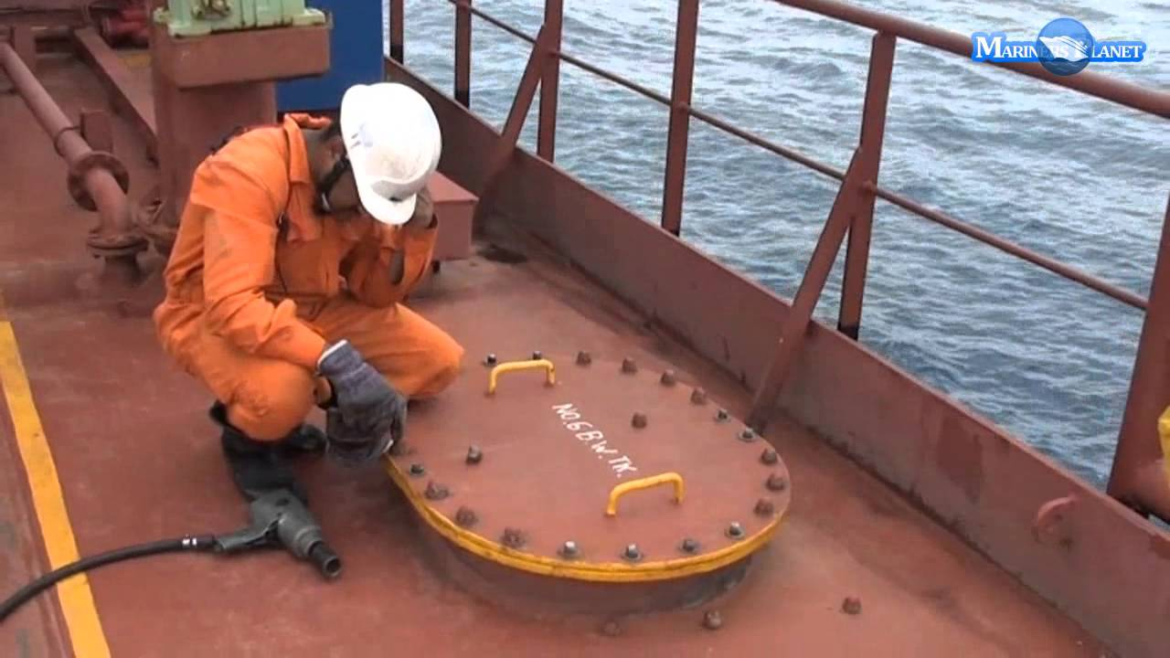
COLD WORK PERMIT
Cold Work Permit shall be obtained for all general work that does not involve activities related to hot work, i.e. the tools and equipment used or the work itself do not generate any spark. Ex:
  Routine maintenance, inspection and condition monitoring activities using non-sparking hand tools, intrinsically safe instruments or explosion proof equipment.
  Excavation by hand tools, erection of scaffolds & barricades, chemical cleaning and use of air driven power tools which do not generate sparks during use.
  Opening of process equipment such as, vessels, towers, pumps, compressors, heat exchangers, filters, tanks, etc.
  Blinding (Spading), blanking, breaking of flanges and unions, tightening of flanges, hot bolting, tapping, cold cutting, hot work preparations, etc.
  Industrial radiography using ionizing radiation source (excluding X-ray generators).

Slide 24
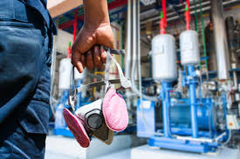
COLD WORK PERMIT
WORKING WITH RESPIRATORY PROTECTION IN OPEN AREAS
Respiratory Protection shall be referred for further details on following clauses.
  Respiratory protection will be required while working in open areas due to presence or the possibility of release of toxic/flammable gas during the course of work.
  Only trained personnel shall wear appropriate respiratory protection.
  Gas masks (canister/cartridge respirators) can be worn if the toxic concentration is known and not Immediately Dangerous to Life).

Slide 25
COLD WORK PERMIT
WORKING ON OR NEAR EQUIPMENT CONTAINING HYDROGEN SULFIDE
  Work on or near (but not inside) any vessel, pipeline, pump, etc., which had been in the service of products containing Hydrogen Sulphide (H2S) shall be handled with additional precautions.
    All personnel working in an environment likely to be contaminated with H2S shall be trained and certified on emergency actions, use of respirators and their limitations.
    After the equipment has been depressurized and purged free of H2S, the flange, valve or manhole, as the case may be, shall be opened by persons wearing airline mask (or SCBA).
    After opening the flange, valve or manhole, the area in the immediate vicinity of the opening shall be checked for the presence of H2S.
    If the H2S reading is above 10 ppm, the use of airline mask or SCBA shall be continued during the work.
    If H2S is above 100 ppm, SCBA or “airline mask with escape cylinder” shall be used.
    If no H2S is detected in the vicinity of the opening, the enclosed space shall be checked for H2S using a long probe.
    H2S shall be less than 10 ppm for people to work without respiratory protection.

Slide 26
COLD WORK PERMIT
WORKING WITH RADIOGRAPHY EQUIPMENT
  When an ionizing radiation source other than X-Ray generator is being used for industrial radiography, or while handling a radioactive source a Cold Work Permit is required in order to protect personnel from the hazards of ionizing radiation.
  X-Ray generators constitute a source of ignition and hence a hot work permit is required.
  Boundaries, based on maximum allowable radiation level of 0.25 mrem/hr (2.5microSV/hr) shall be defined and roped off.
  Work shall be scheduled when the number of people are minimum in the area such as weekend, night or break times.
  Adequate warning signs on the outskirts of the roped area shall be provided.
  Warning flashlights shall be provided for night radiography.
  Authorised person shall announce start of the job.
  Authorized person shall at all times be present on site in a safe area during radiography.
  Personnel handling radiography equipment shall wear film badges and Dosimeters.
  Dosimeter readings shall be checked prior to and following the exposure in addition to weekly checks.

Slide 27
HOT WORK PERMIT
GENERAL REQUIREMENTS FOR HOT WORK
  The issuer of the Hot Work Permit is responsible for ensuring that the site and the equipment (vessel, piping, etc) are properly prepared to prevent the danger of fire & explosion involving flammable material.
  Issuer shall ensure that, the equipment is emptied, cleaned of flammable materials and isolated from sources of hydrocarbons by means of disconnection, blanking or insertion of blinds.
  Isolation by closed valve only is allowed if, there is no other possible way of isolation and this has been approved by Safety.
  Issuer & executor shall ensure that, within 15 meter of a hot work site, any sample point, drain, surface manhole cover or relief valve outlet are covered to prevent the escape of flammable gas and vapors.
  They shall also ensure that, these seals are maintained in good condition.
  If there are any open drains or ditches into which flammable liquid can escape, the same shall be dammed and pumped dry.
  Outlets of all unit drains shall be plugged to isolate them from the rest of the sewer system.

Slide 28
HOT WORK PERMIT
  Authorised Gas Tester shall conduct the test for flammable gases (%LEL) in a radius of 15 meters at location of work. (LEL 1% or less,).
  LEL test is a must for all hot work including vehicle/equipment entry and use of battery/power operated ordinary equipment in hazardous area.
  Before hot cutting a long pipe, cold cut or hole shall be made to test combustible gases at the point of cut.
  If hot work is to be done at height, then precautions shall be taken to prevent the spread of sparks and molten metal by surrounding the work area with fire-resisting/flame-retardant tarpaulin or metal sheets.
  Proper ventilation/ air circulation for the welder should be ensured.
  Barricade should also prevent direct eye contact of others with welding arc.
  Executor shall arrange water for quenching sparks or molten slag and minimum of 2 fire extinguishers within 8 meters from the place of hot work.
  Extinguishers, hoses and nozzles in process area shall not be used for this purpose.
  Issuer shall inform the Fire Station about critical hot work.
  Executor shall ensure that the work area be made safe at the end of the job/work-day.

Slide 29
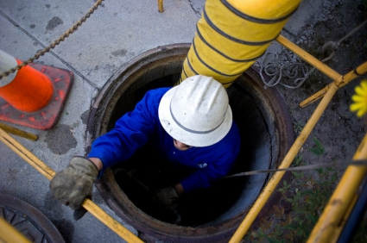
CONFINED SPACE ENTRY AUTHORIZATION
A Confined Space is any space large enough for a man to enter where, there could be presence of hazardous material, or there is likelihood of deficiency of oxygen, or access or exit is difficult or restricted. Ex. Vessels, tanks, furnaces, pits, manholes, sewers, excavation deeper than 1.2 meters, entry on floating roof tanks when the roof is more than 3 meters down from the top, etc.
Work within a confined space requires a Confined Space Entry Authorisation in addition to the hot or cold work permit.
Serial number of work and entry authorisation permits shall be cross-referred in each permit.

Slide 30
EXCAVATION AUTHORIZATION
An excavation authorization associated with the work permit is required for all excavations .
Copy of authorisation shall be attached to the work permit.
Serial no. of authorisation shall be written against associated Excav no.
A Cold Work Permit is required if non-sparking hand tools are being used for excavation and a Hot Work Permit if powered tools or mechanical equipment are being used (ex. jackhammer, backhoe).
For excavations more than 1.2 meter deep a Confined Space Entry Authorization is also required.
WAIVER: In emergency situations (e.g., rupture of a pipeline) an excavation may be required beyond the normal working hours or on weekends/holidays.
In such cases the Shift Leader can waive the requirement for obtaining an Excavation Authorization for carrying out urgent repairs.
He shall advise the issuing authority to issue Cold Work Permit without excavation authorisation to contain the emergency.
No mechanical excavations are permitted in such cases except, for the removal of concrete or asphalt.

